Slide 2
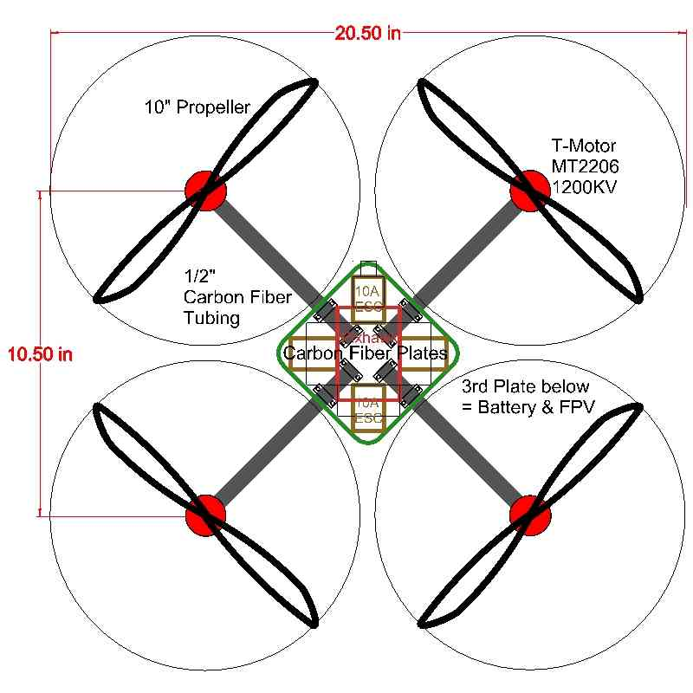
Calculating safe distance b/w two drones
radius1
radius2
x1
x2
Safe distance = 2*(radius1 + radius2)
Configurable as per requirement
(abs(x1 - x2) > safe distance) AND (abs(y1 - y2) > safe distance) AND (abs(z1 - z2) > safe distance)

